Slide 1

ANALYSIS ON INTERNATIONAL SOCCER PLAYERS through fifa 18 Statistics
Ameya Munagekar
Priyesh Jain
Pushpal Jagdale

Slide 2
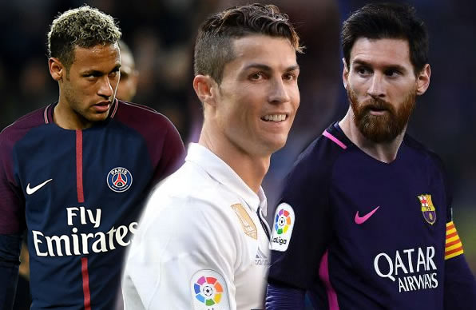
Wouldn’t it be wonderful if we have a dream team that includes the best soccer players at their respective positions?

Slide 3
Objective
To determine the ideal team according to the skills of the players listed as features imported through EA Sports FIFA 18 dataset.
Plan of Action
1. Exploratory data analysis.
2. Performing hierarchical and k-means clustering on the player dataset.
3. Making an ideal or dream team based on the cluster outputs.

Slide 4
Data Description
Features | Description
Player Name | List consisting names of all international players.
Age | Age of the current players in year 2018.
Player Position | The position where the player is currently playing and their position preferences.
Strength | Different players have their unique strength such as some might be good at penalties, some for free-kick and some for corners etc.
Acceleration | How quick the players get off the mark and up to top speed.
Dribbling | Dribbling involves keeping the ball moving between the player's feet by kicking it from one foot to the other.
Balance | Balance is how much a player can be overpowered before they physically fall
Data Size: 17,681 rows and 76 columns

Slide 5
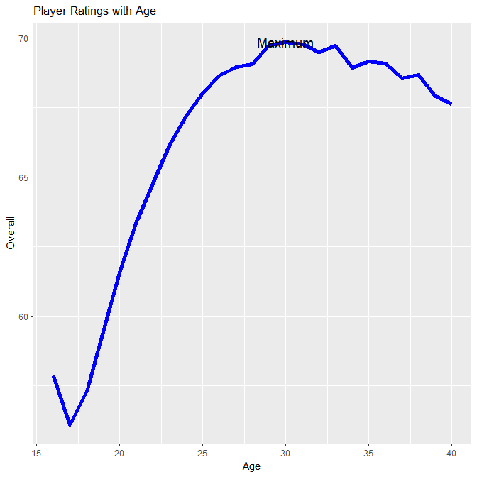
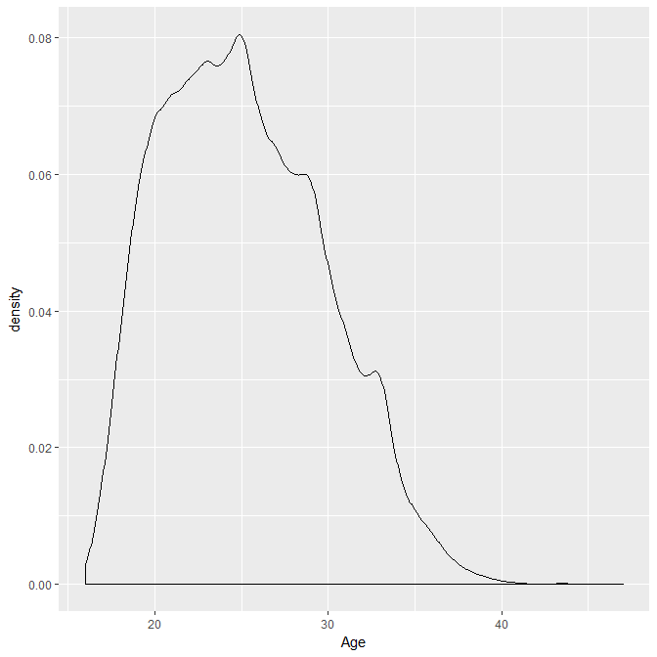
Exploratory Data Analysis
Age Density

Slide 6
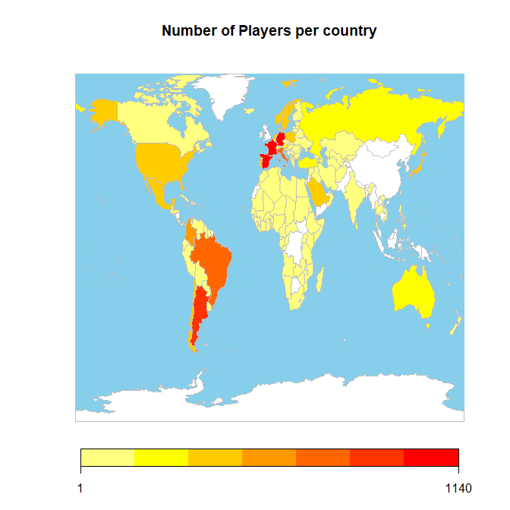
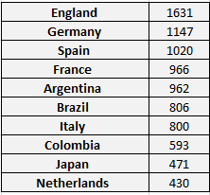
Where do they come from?

Slide 7
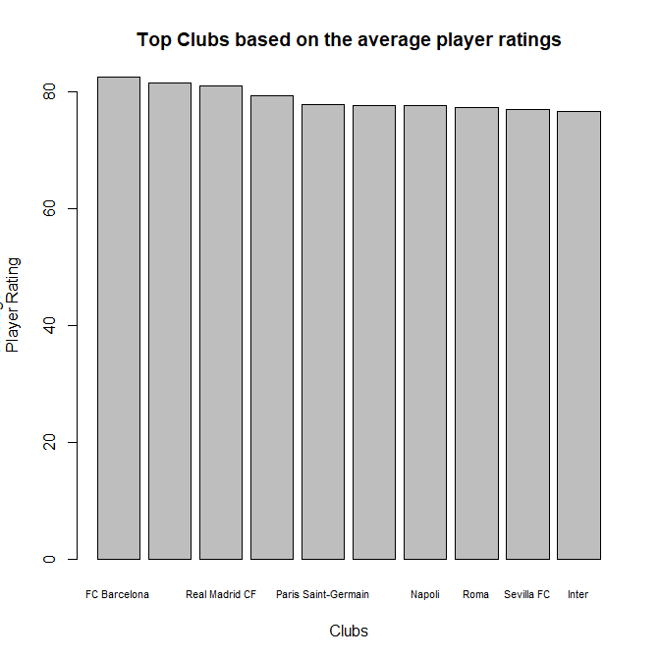
Benchmarking…

Slide 8
Data Preprocessing
The dataset has 75 features out of which 33 features pertaining to the skills of the players were incorporated in our model.
For clustering, we needed the player skills – ball control, balance, gk.skills etc..
The data had 17,981 rows but we considered only the top 100 players due to computational constraints. The players were chosen according to the overall rating.

Slide 9
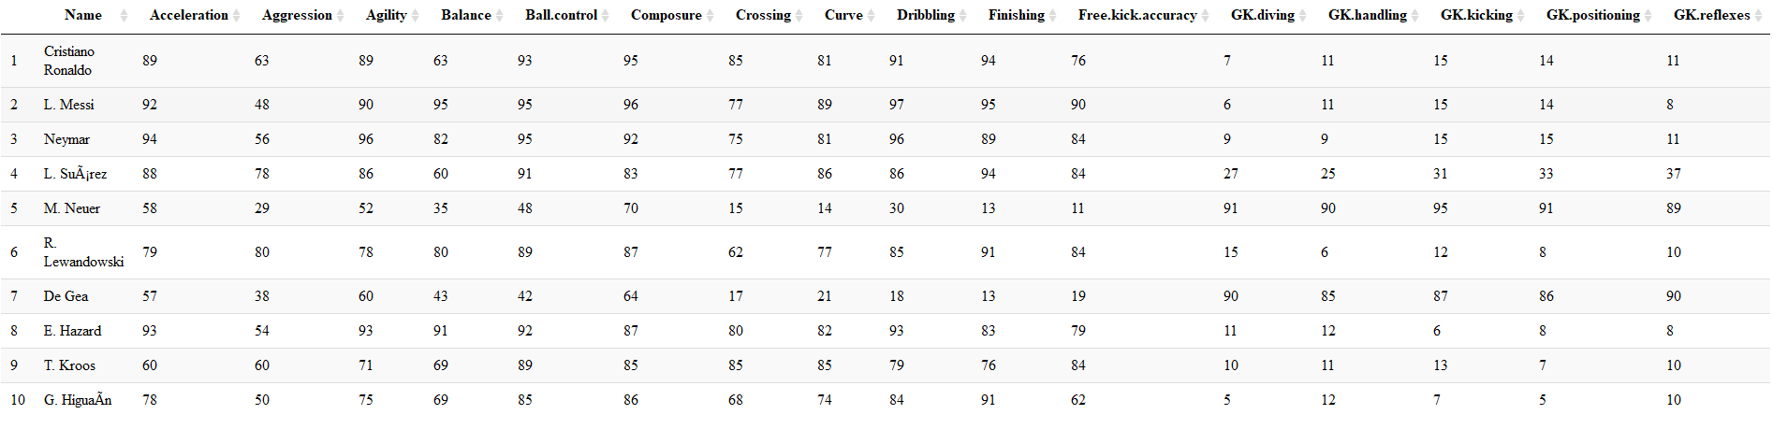
Considering the features required for our model…

Slide 10
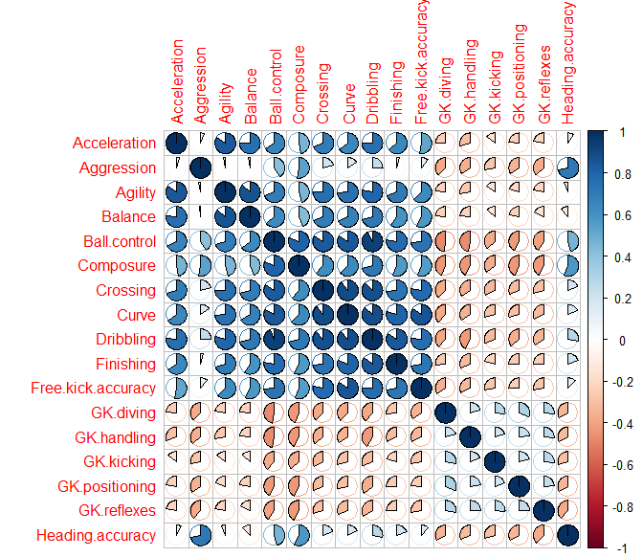
Checking the Correlation among features…

Slide 11
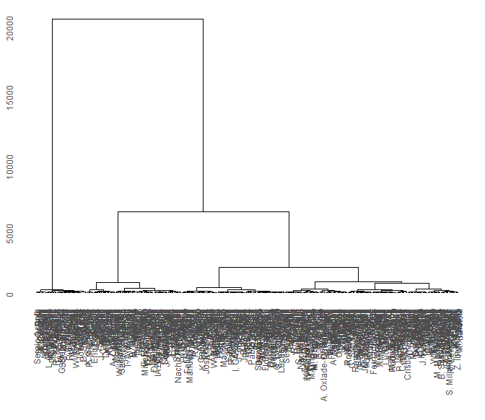
Hierarchical clustering

Slide 12
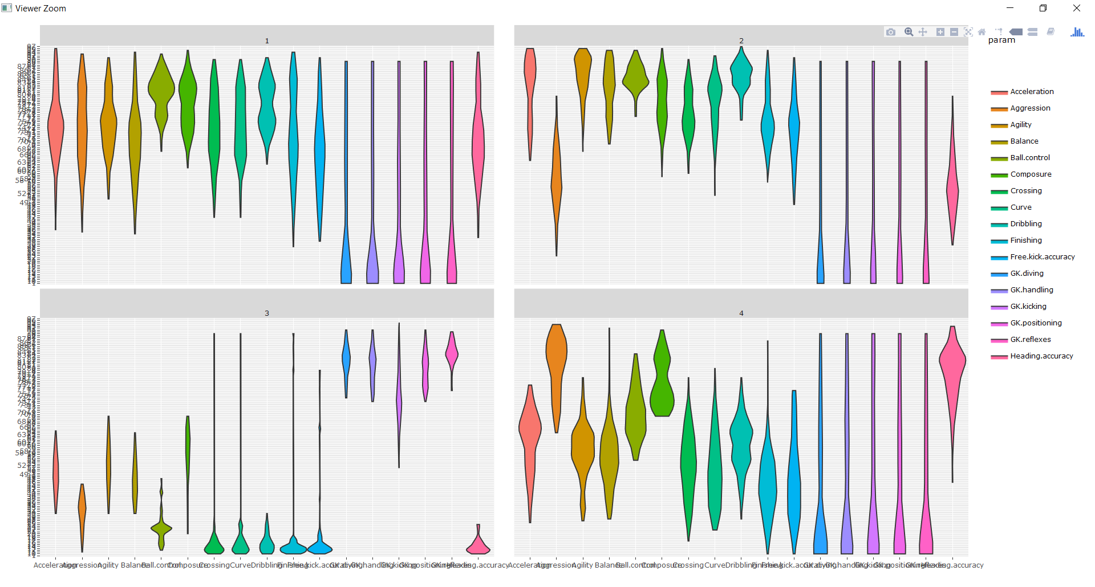
Interpreting the clusters
Cluster 1: All skills are high.
Cluster 2: Almost all skills are high but low Aggression Heading Accuracy.
Cluster 3: Extremely high GK skills.
Cluster 4: Almost all skills are moderate but high Aggression and Composure.

Slide 13
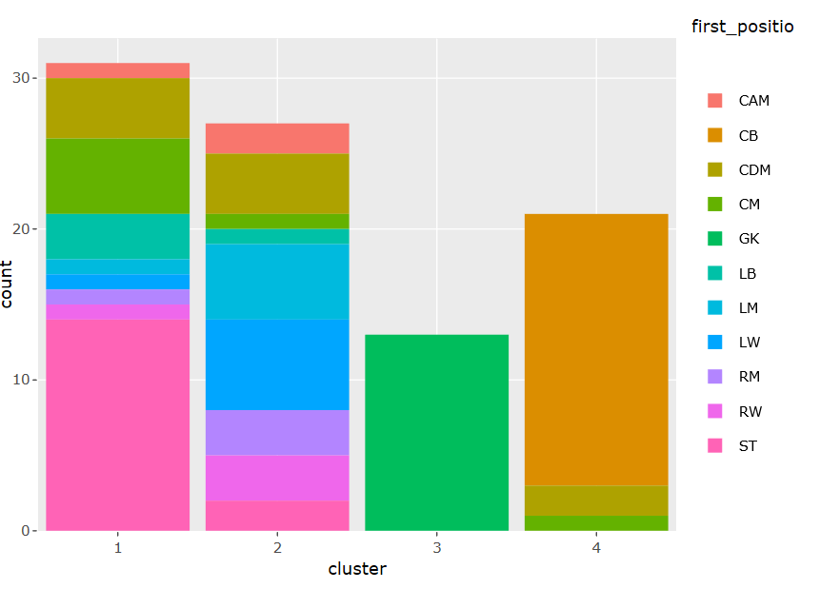
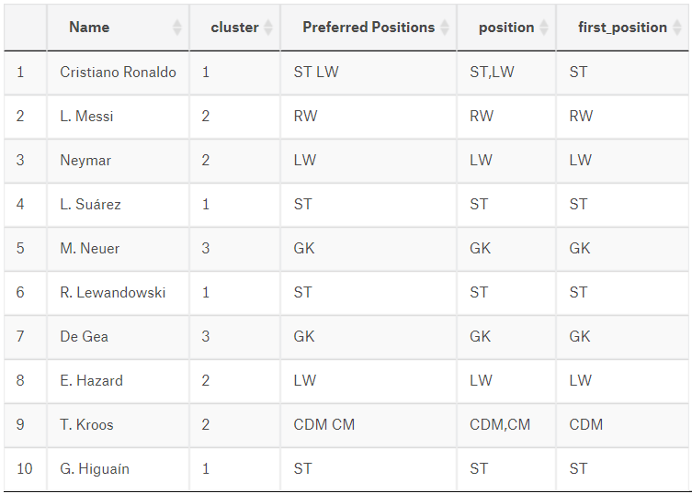
Which position belongs to which cluster..

Slide 14
Inference
Cluster 1: All skills are high. -> Striker.
Cluster 2: Almost all skills are high but low Aggression and Heading Accuracy. -> Midfielders.
Cluster 3: Extremely high GK skills. -> Goalkeepers.
Cluster 4: Almost all skills are moderate but high Aggression and Composure. -> Defenders.

Slide 15
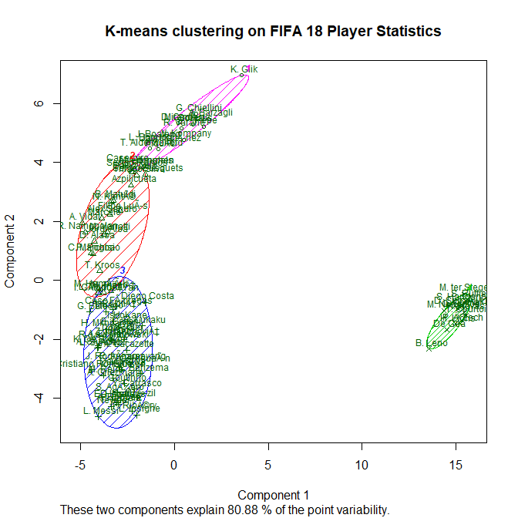
K means clustering
Taking care of missing data
Scaling the dataset
Deciding the number of clusters
Number of clusters = 4

Slide 16
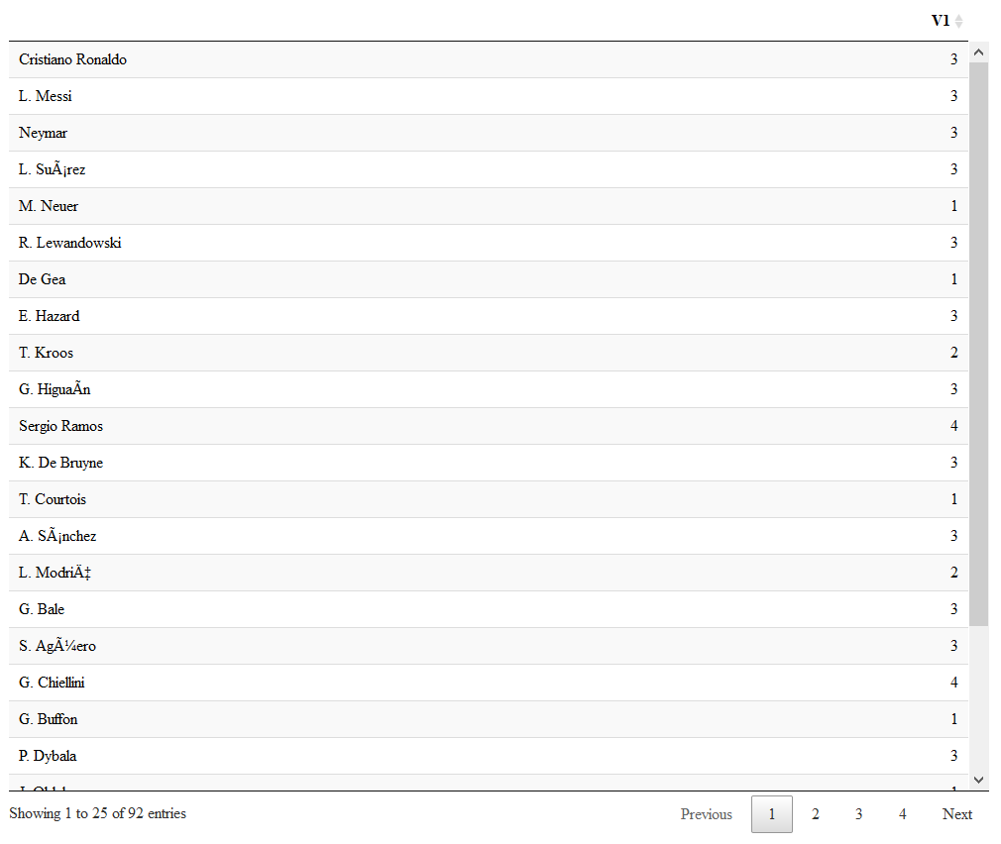
K means clustering
Here we see that the players are clustered almost similar to hierarchical clustering.

Slide 17
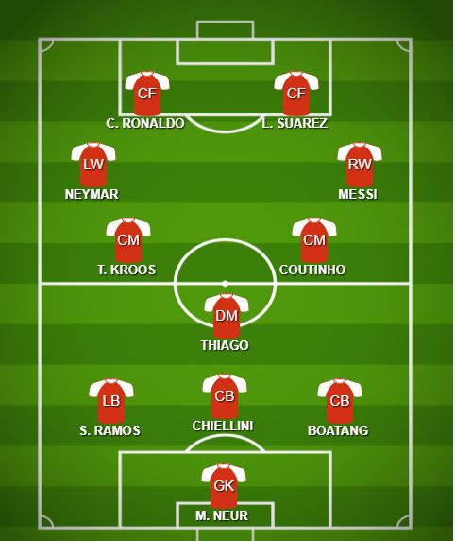
Dream Team
Team rating = 92.90
Best team in the dataset
Barcelona’s rating = 87.00

Slide 18
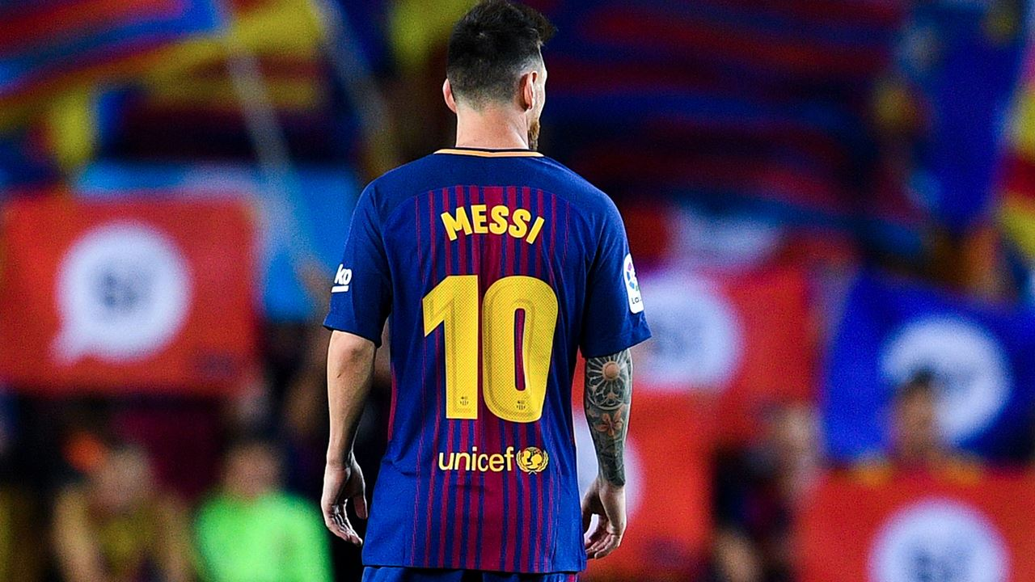
QUESTIONS??

